Slide 1
Finance Analysis

Slide 2
Introduction
Analyzing competition is crucial for business survival and strategic decision-making. This task involves examining the market capitalization of the top 500 companies in India, providing a comprehensive view of the competitive landscape. By understanding the market positions and financial strength of these leading firms, management can identify key industry trends, benchmark performance, and uncover opportunities for growth. This analysis will equip the organization with insights to navigate competitive pressures, enhance market positioning, and drive better business results.

Slide 3
Details of Data
Serial Number
Name of Company– total 500 companies
Mar Cap – CroreMarket
Capitalization in Crores
Sales Qtr – Crore Quarterly Sale in crores

Slide 4
Main KPIs
Market Capitalization (Mar Cap – Crore):The total market value of a company's outstanding shares.
Quarterly Sales (Sales Qtr – Crore):The total revenue generated by the company in a specific quarter
Market Capitalization to Quarterly Sales Ratio:Ratio of market capitalization to quarterly sales.
Growth Rate in Market Capitalization:The percentage change in market capitalization over a specified period
Growth Rate in Quarterly Sales:The percentage change in quarterly sales compared to the previous quarter.

Slide 5
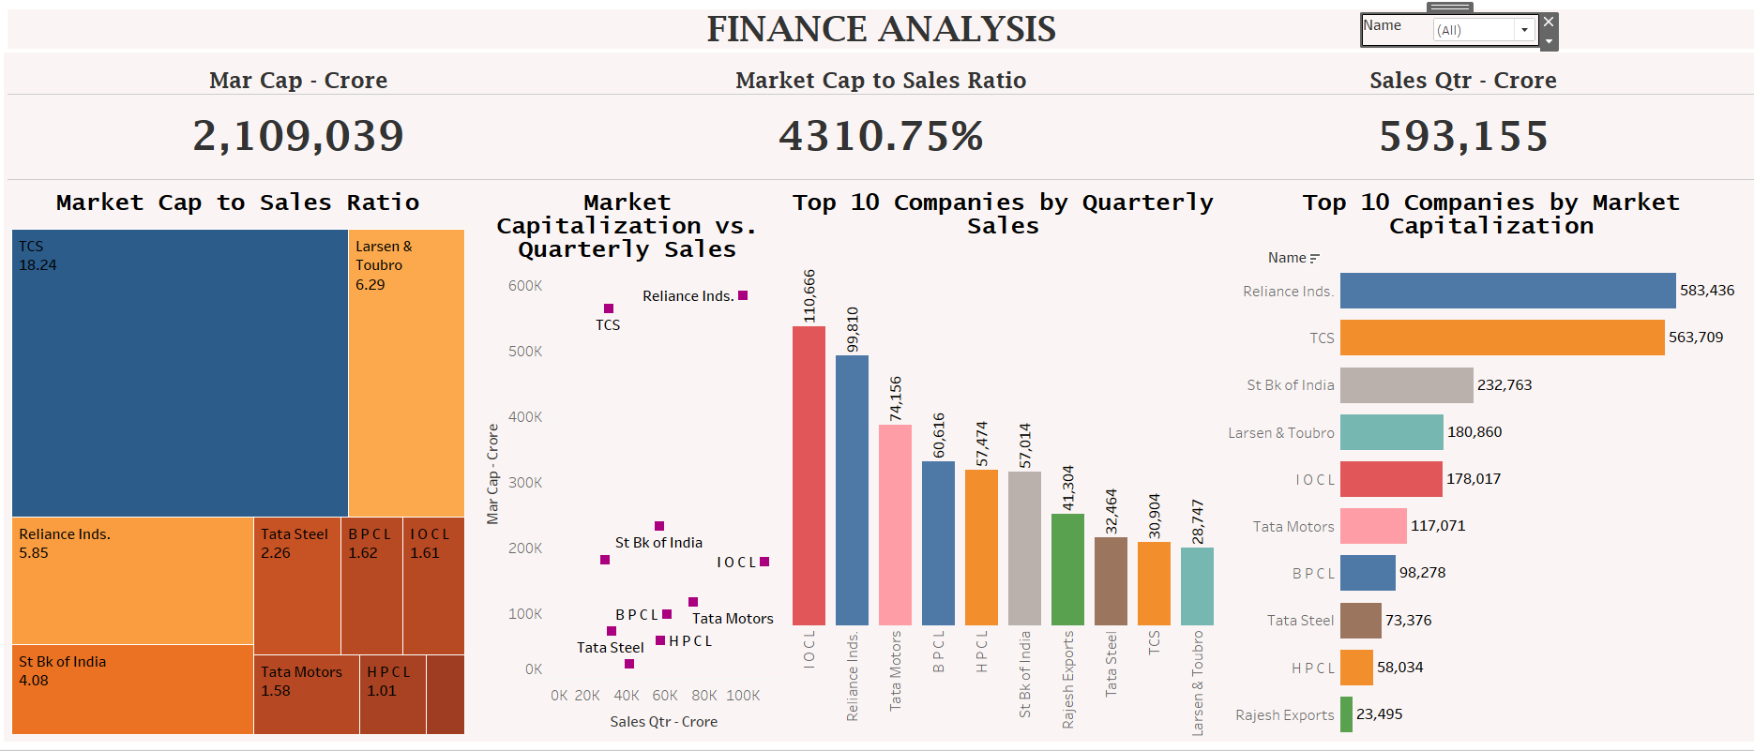
Dashboard

Slide 6
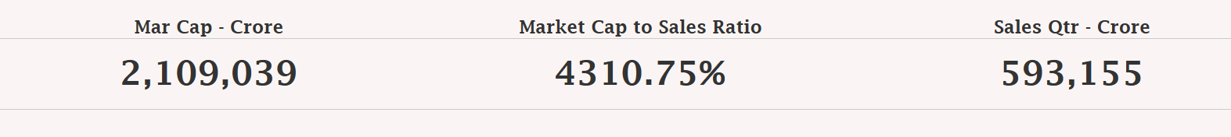
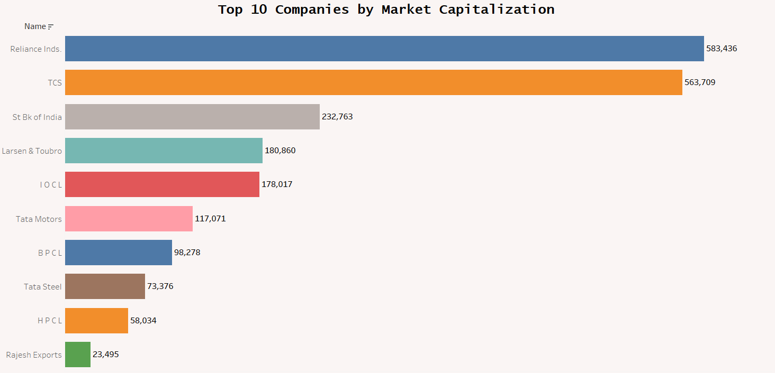
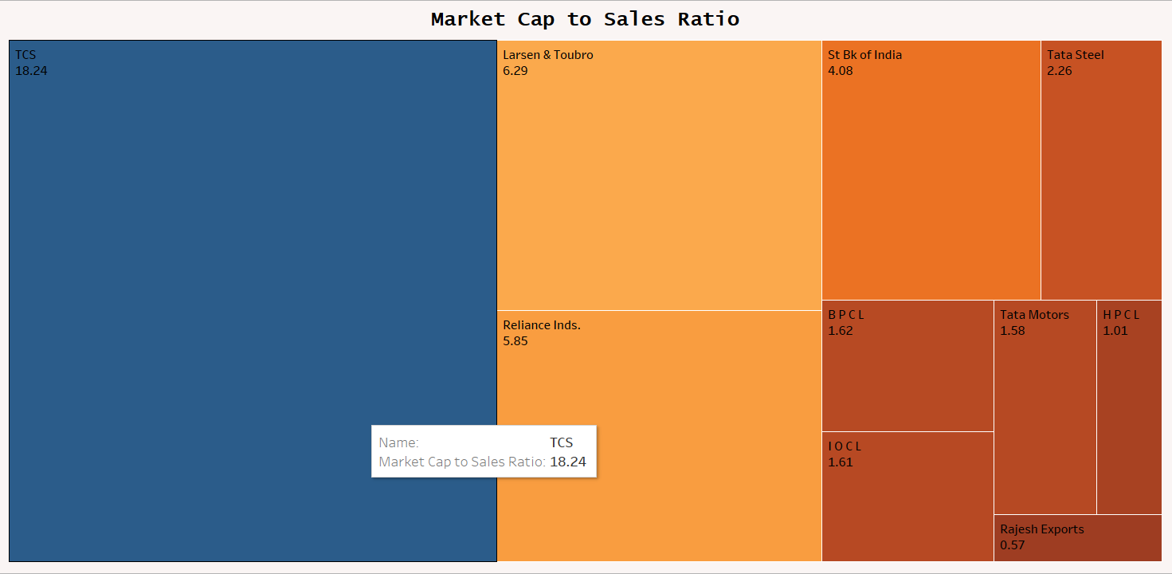
My Designs

Slide 7
Thank you

